Slide 1
Introduction to SQL

Slide 2
SQL is a standard language for accessing and manipulating databases.
What is SQL?
- SQL stands for Structured Query Language
- SQL lets you access and manipulate databases
-SQL became a standard of the American National Standards Institute (ANSI) in 1986, and of the International Organization for Standardization (ISO) in 1987
What Can SQL do?
- SQL can execute queries against a database
- SQL can retrieve data from a database
- SQL can insert records in a database
- SQL can update records in a database
- SQL can delete records from a database
- SQL can create new databases
- SQL can create new tables in a database
- SQL can create stored procedures in a database
- SQL can create views in a database
- SQL can set permissions on tables, procedures, and views

Slide 3
In 1970 –E. F. Codd[father of DBMS]
SQL is a Domain Specific language
SQL is a Declarative Language
In declarative language will use different commands for different Purpose
DDL ,DML,DCL,TCL
Keys and Constraints
To create a relation will apply some rules called constraint
Operators(Like, between , not in ,In ,Conditional
Clauses(distinct , order by, group by, from , having)
Aggregate Function(count , average)
Join and nested queries
PLSQL(triggers , create function, create cursor ,create procedure

Slide 4
SQL commands
DDL ,DML,DCL,TCL
DDL
DML
DCL
TCL
Create
Select
Commit
Grant
Alter
Insert
Roll back
Update
Revoke
Drop
Save Point
Truncate
Delete
Rename

Slide 5
Constraints
Primary key
Foreign key
Check
Unique
Default
Not Null

Slide 6
RDBMS
RDBMS stands for Relational Database Management System.
RDBMS is the basis for SQL, and for all modern database systems such as MS SQL Server, IBM DB2, Oracle, MySQL, and Microsoft Access.
The data in RDBMS is stored in database objects called tables. A table is a collection of related data entries and it consists of columns and rows.
Every table is broken up into smaller entities called fields.
The fields in the Customers table consist of CustomerID, CustomerName, ContactName, Address, City, PostalCode and Country.
A field is a column in a table that is designed to maintain specific information about every record in the table.
A record, also called a row, is each individual entry that exists in a table.
For example, there are 91 records in the above Customers table. A record is a horizontal entity in a table.
A column is a vertical entity in a table that contains all information associated with a specific field in a table.
An SQL Schema is identified as Schema Name [tables , types , constraints , views , domain , authorization grant]

Slide 7
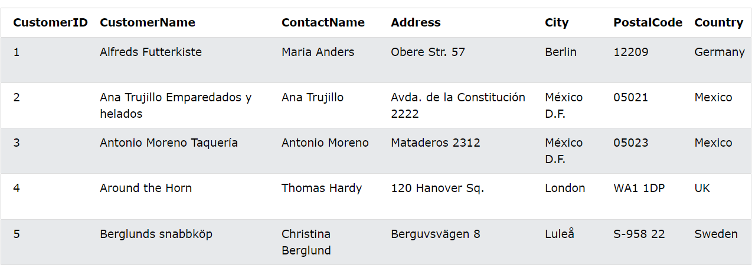

Slide 8
SQL Syntax
SQL Statements
- Most of the actions you need to perform on a database are done with SQL statements.
- SQL statements consists of keywords that are easy to understand.
Create Schema Company Authorizaton “XXX”;
The following SQL statement returns all records from a table named "Customers":
SELECT * FROM Customers;
Database Tables
A database most often contains one or more tables. Each table is identified by a name (e.g. "Customers" or "Orders"), and contain records (rows) with data.

Slide 9
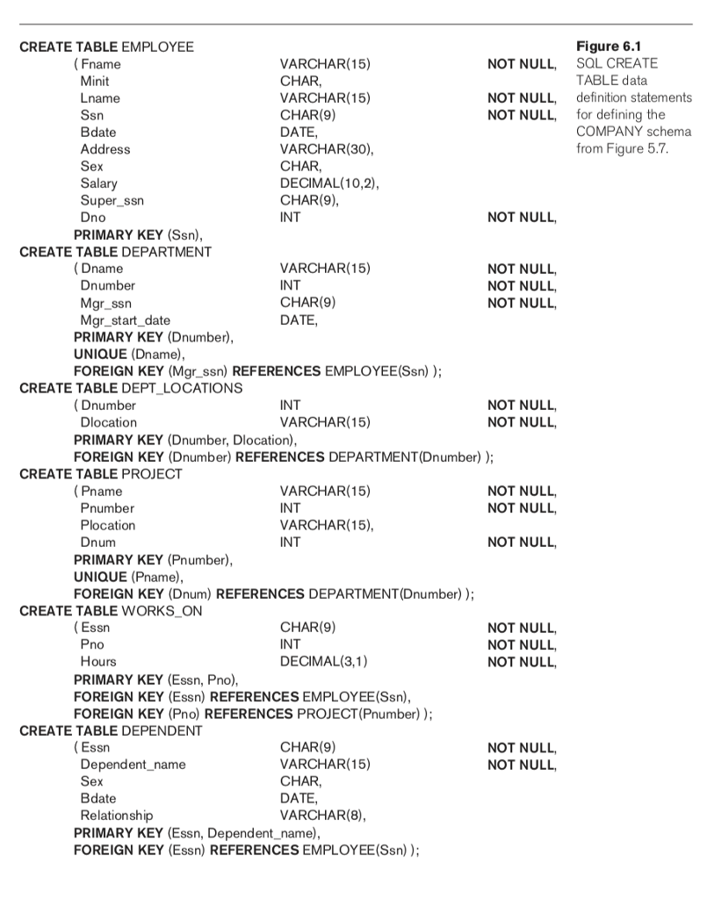

Slide 10
Some of The Most Important SQL Commands
SELECT - extracts data from a database
UPDATE - updates data in a database
DELETE - deletes data from a database
INSERT INTO - inserts new data into a database
CREATE DATABASE - creates a new database
ALTER DATABASE - modifies a database
CREATE TABLE - creates a new table
ALTER TABLE - modifies a table
DROP TABLE - deletes a table
CREATE INDEX - creates an index (search key)
DROP INDEX - deletes an index

Slide 11
SQL Commands
Show Databases;
CREATE DATABASE databasename;
DROP DATABASE databasename;
CREATE TABLE table_name ( column1 datatype, column2 datatype, column3 datatype, .... );
create table employee ( ID int, Name varchar(25), );
Create Table Using Another Table
The column parameters specify the names of the columns of the table.
The datatype parameter specifies the type of data the column can hold (e.g. varchar, integer, date, etc.).

Slide 12
Alter Command
Add Column/s
Remove Column/s
Modify datatype
Modify datatype length
Add constraints
Remove Constraints
Rename column/table
alter table employee add address varchar(10);
alter table employee drop column address;
alter table employee modify id varchar(10);
alter table employee rename column id to roll_no;
alter table employee rename to emp22;
Alter table employee add primary key(roll_no);
desc employee;

Slide 13
DROP TABLE Person;
CREATE TABLE Persons ( PersonID int, LastName varchar(255), FirstName varchar(255), Address varchar(255), City varchar(255) );
The SQL INSERT INTO Statement
INSERT INTO table_name (column1, column2, column3, ...) VALUES (value1, value2, value3, ...);
or
INSERT INTO table_name VALUES (value1, value2, value3, ...);
INSERT INTO Customer (CustomerID,CustomerName, ContactName, Address, City, PostalCode, Country)VALUES ('Cardinal', 'Tom B. Erichsen', 'Skagen 21', 'Stavanger', '4006', 'Norway');
INSERT INTO Customers (CustomerName, City, Country)
VALUES ('Cardinal', 'Stavanger', 'Norway');
INSERT INTO Customers (CustomerName, ContactName, Address, City, PostalCode, Country) VALUES ('Cardinal', 'Tom B. Erichsen', 'Skagen 21', 'Stavanger', '4006', 'Norway'), ('Greasy Burger', 'Per Olsen', 'Gateveien 15', 'Sandnes', '4306', 'Norway'), ('Tasty Tee', 'Finn Egan', 'Streetroad 19B', 'Liverpool', 'L1 0AA', 'UK');

Slide 14
SELECT Country FROM Customers;
SELECT DISTINCT Country FROM Customers;
SELECT COUNT(DISTINCT Country) FROM Customers;
SELECT Count(*) AS DistinctCountries FROM (SELECT DISTINCT Country FROM Customers);

Slide 15
SPECIFYING CONSTRAINTS IN SQL:
key and referential integrity constraints(NOT NULL,Default,Check)
restrictions on attribute domains and NULLs(Primary key,UNIQUE,Foreign KEY)
Referential Triggered action(SET NULL,CASCADE ,SET DEFAULT)
ON DELETE and ON UPDATE
constraints on individual tuples(rows) within a relation.
tuple-based constraints because they apply to each tuple individually and are checked whenever a tuple is inserted or modified.

Slide 16
SCHEMA CHANGE STATEMENTS IN SQL:
It is also possible to drop a schema. For example, if a whole schema is not needed any more,
the DROP SCHEMA command can be used.
There are two drop behavior options: CASCADE and RESTRICT.
CREATE , ALTER , DROP SCHEMA – SCHEMA CHANGE

Slide 17
ALTER TABLE COMPANY.EMPLOYEE ADD COLUMN job VARCHAR(12);
ALTER TABLE COMPANY.EMPLOYEE DROP COLUMN Address CASCADE;
ALTER TABLE COMPANY.DEPARTMENT ALTER COLUMN MGRSSN DROP DEFAULT;
ALTER TABLE COMPANY.DEPARTMENT ALTER COLUMN MGRSSN SET DEFAULT
"333445555";
ALTER TABLE COMPANY.EMPLOYEE DROP CONSTRAINT EMPSUPERFK
CASCADE;

Slide 18
The SQL WHERE Clause
The WHERE clause is used to filter records. It is used to extract only those records that fulfill a specified condition.
SELECT * FROM Customers WHERE Country='Mexico';
SELECT * FROM Customers WHERE CustomerID=1;
Operators in The WHERE Clause
SELECT * FROM Customers
WHERE CustomerID > 80;

Slide 19
SQL ORDER BY Keyword
The ORDER BY keyword is used to sort the result-set in ascending or descending order.
select * from customer
order by CustomerName;
The ORDER BY keyword sorts the records in ascending order by default. To sort the records in descending order, use the DESC keyword.
SELECT * FROM Products
ORDER BY Price DESC;
For string values the ORDER BY keyword will order alphabetically:
To sort the table reverse alphabetically, use the DESC keyword:
The following SQL statement selects all customers from the "Customers" table, sorted by the "Country" and the "CustomerName" column. This means that it orders by Country, but if some rows have the same Country, it orders them by CustomerName:
select * from Customers
order by Country, CustomerName;

Slide 20
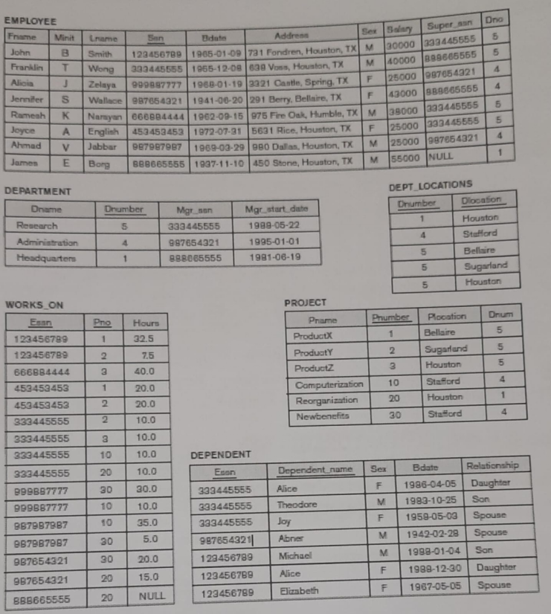

Slide 21


Slide 22
Aggregate Function
MAX
MIN
AVG
SUM
Count

Slide 23
Emp | E-id | E-name | Dept | Salary
 | 1 | Rahul | HR | 10000
 | 2 | Aman | MRKT | 20000
 | 3 | Naveen | HR | 30000
 | 4 | Nutan | MRKT | 4 0000
 | 5 | Arun | IT | 50000
 | 6 | Sandy | Testing | NULL

Slide 24
Group by Clause
The GROUP BY clause is a SQL command that is used to group rows that have the same values.
The GROUP BY clause is used in the SELECT statement.
Optionally it is used in conjunction with aggregate functions to produce summary reports from the database.
SELECT statements... GROUP BY column_name1[,column_name2,...] [HAVING condition];
“SELECT statements…” is the standard SQL SELECT command query.
“GROUP BY column_name1” is the clause that performs the grouping based on column_name1.
“[,column_name2,…]” is optional; represents other column names when the grouping is done on more than one column.
“[HAVING condition]” is optional; it is used to restrict the rows affected by the GROUP BY clause. It is similar to the WHERE clause.

Slide 25
Having Clause
Restricting query results using the HAVING clause
It’s not always that we will want to perform groupings on all the data in a given table. There will be times when we will want to restrict our results to a certain given criteria. In such cases , we can use the HAVING clause

Slide 26
IN / Not IN
SQL IN and NOT IN operators used to specify multiple values in a WHERE clause.
SQL IN condition used to allow multiple value in a WHERE clause condition. SQL IN condition you can use when you need to use multiple OR condition.
SQL NOT IN condition used to exclude the defined multiple value in a WHERE clause condition.
SQL NOT IN condition also identify by NOT operator.

Slide 27
Emp | E-id | E-name | Address
 | 1 | Rahul | Haryana
 | 2 | Aman | Delhi
 | 3 | Naveen | Pune
 | 4 | Nutan | Bangalore
 | 5 | Arun | Haryana
Proj | E-id | P-id | Pname | Location
 | 1 | P1 | IOT | Bangalore
 | 5 | P2 | BD | Delhi
 | 3 | P3 | DS | Mumbai
 | 4 | P4 | Web | Hydrabad

Slide 28


Slide 29
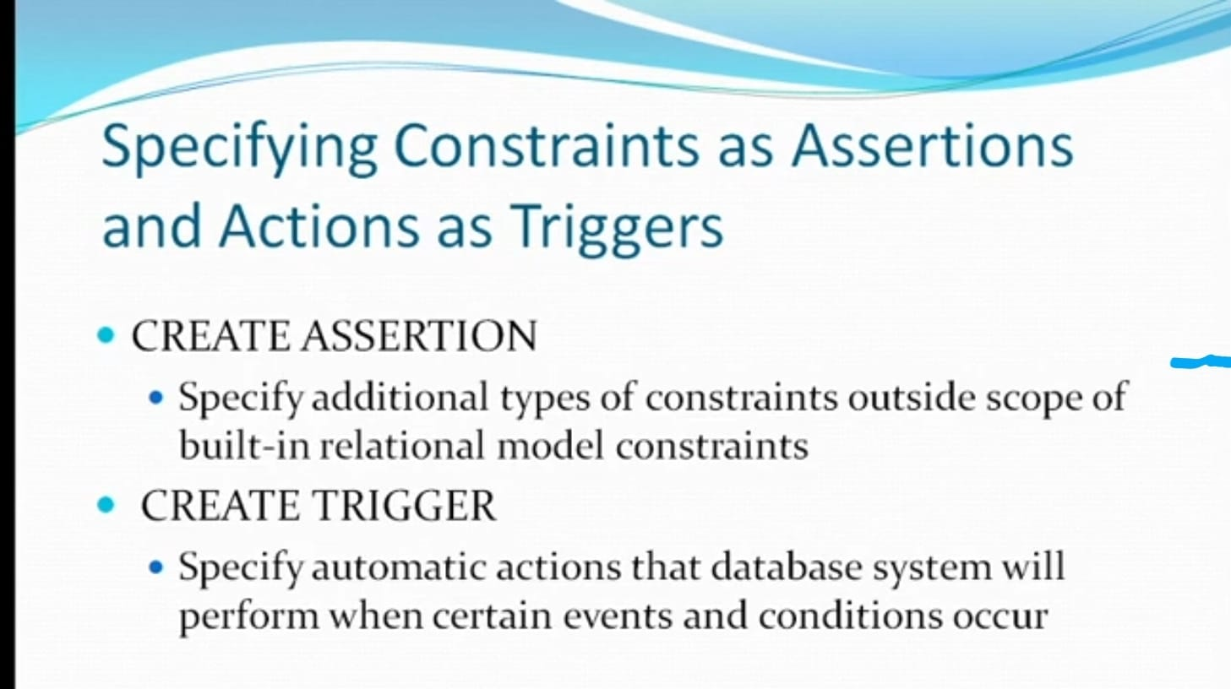

Slide 30
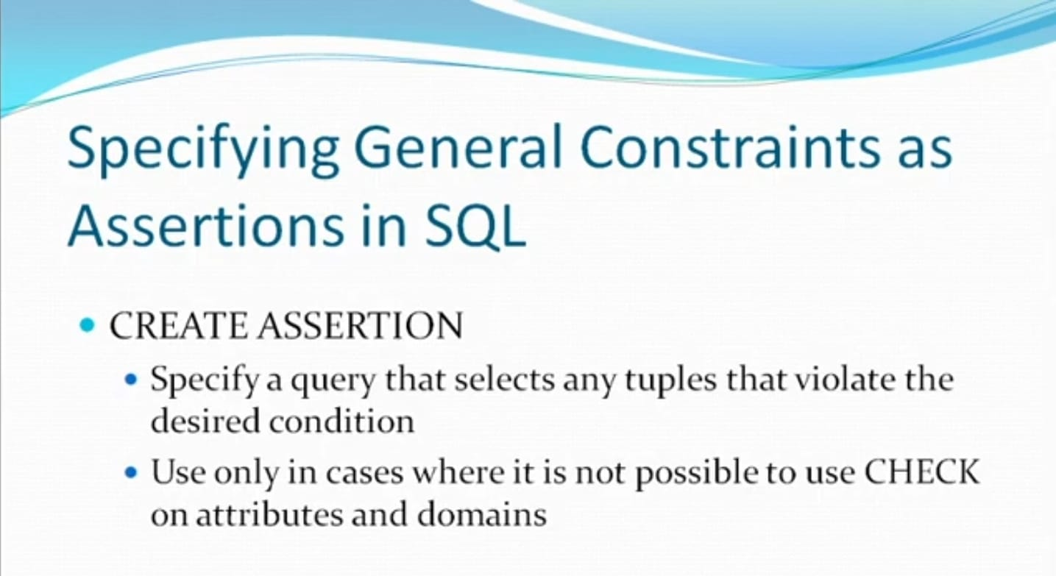

Slide 31
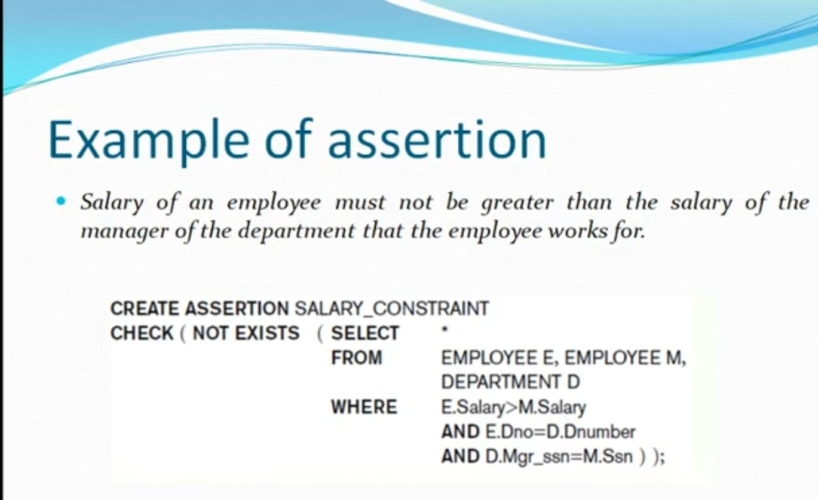

Slide 32
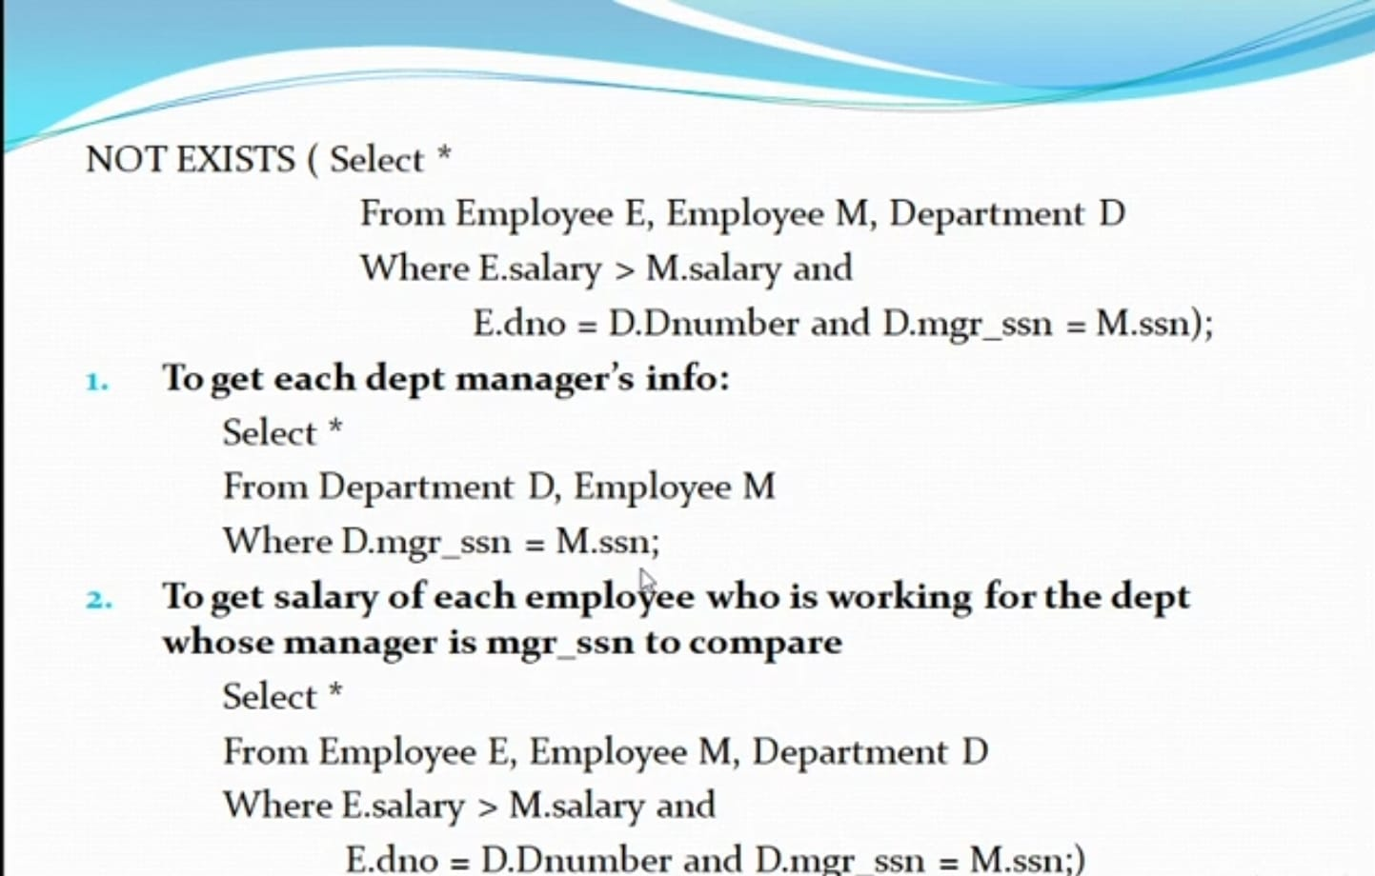

Slide 33
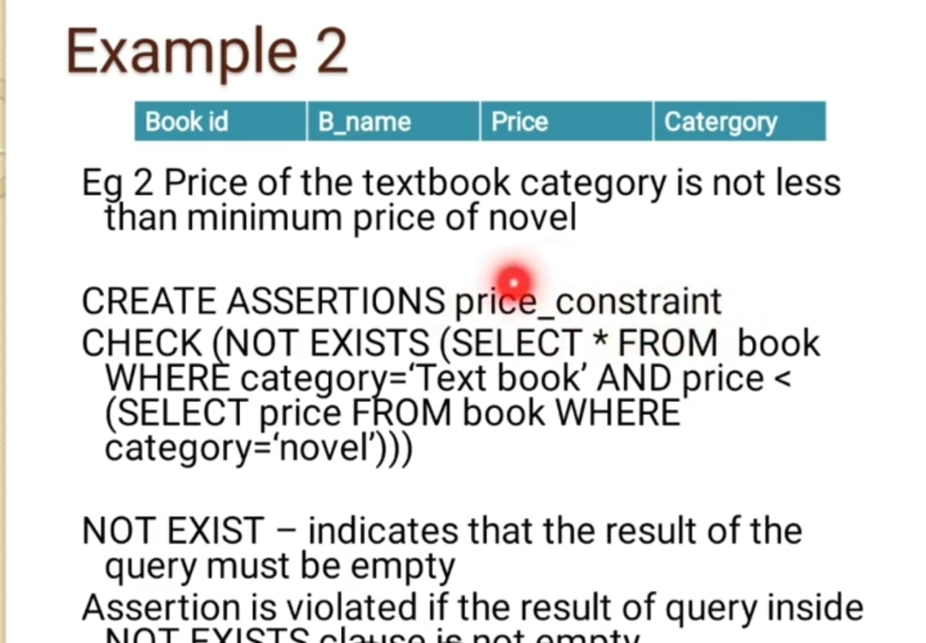

Slide 34
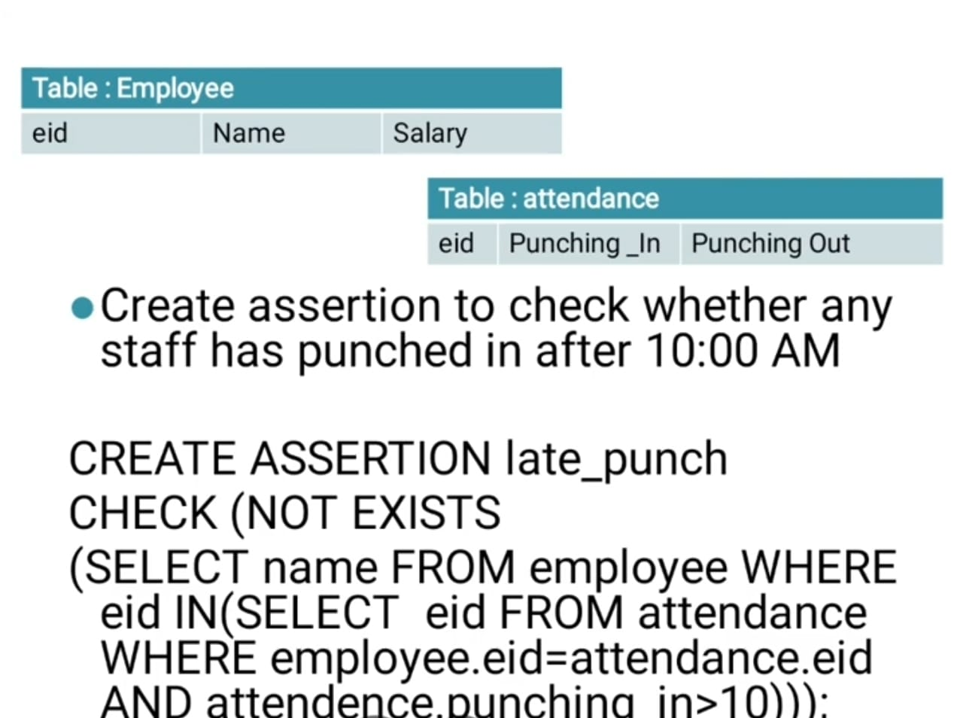

Slide 35
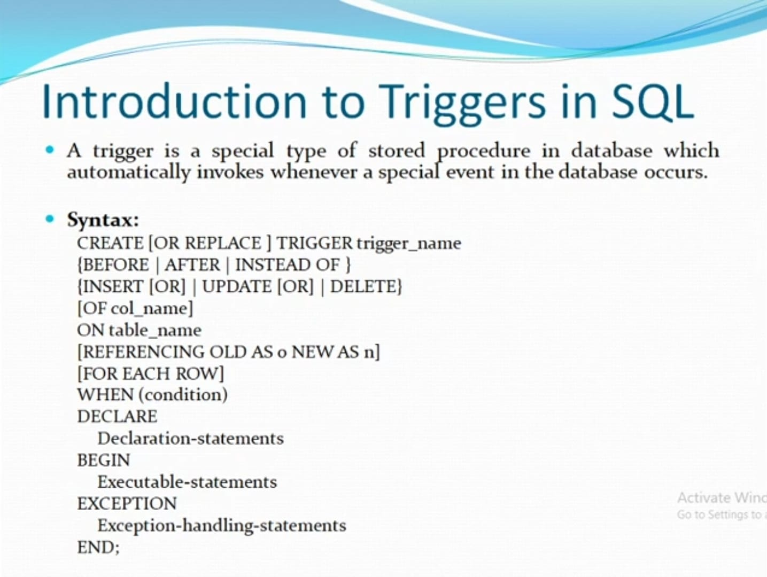

Slide 36
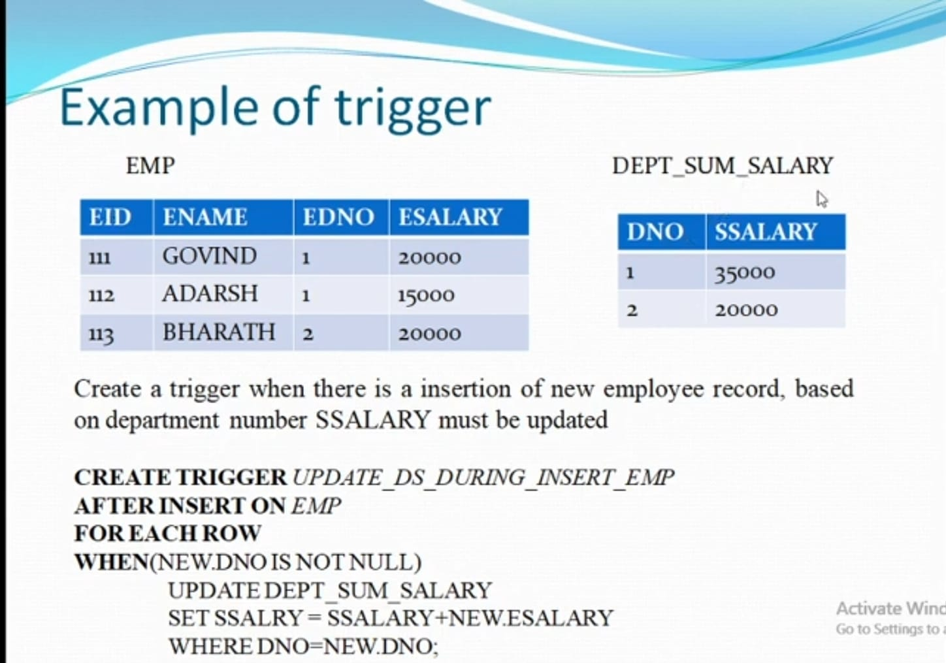

Slide 37
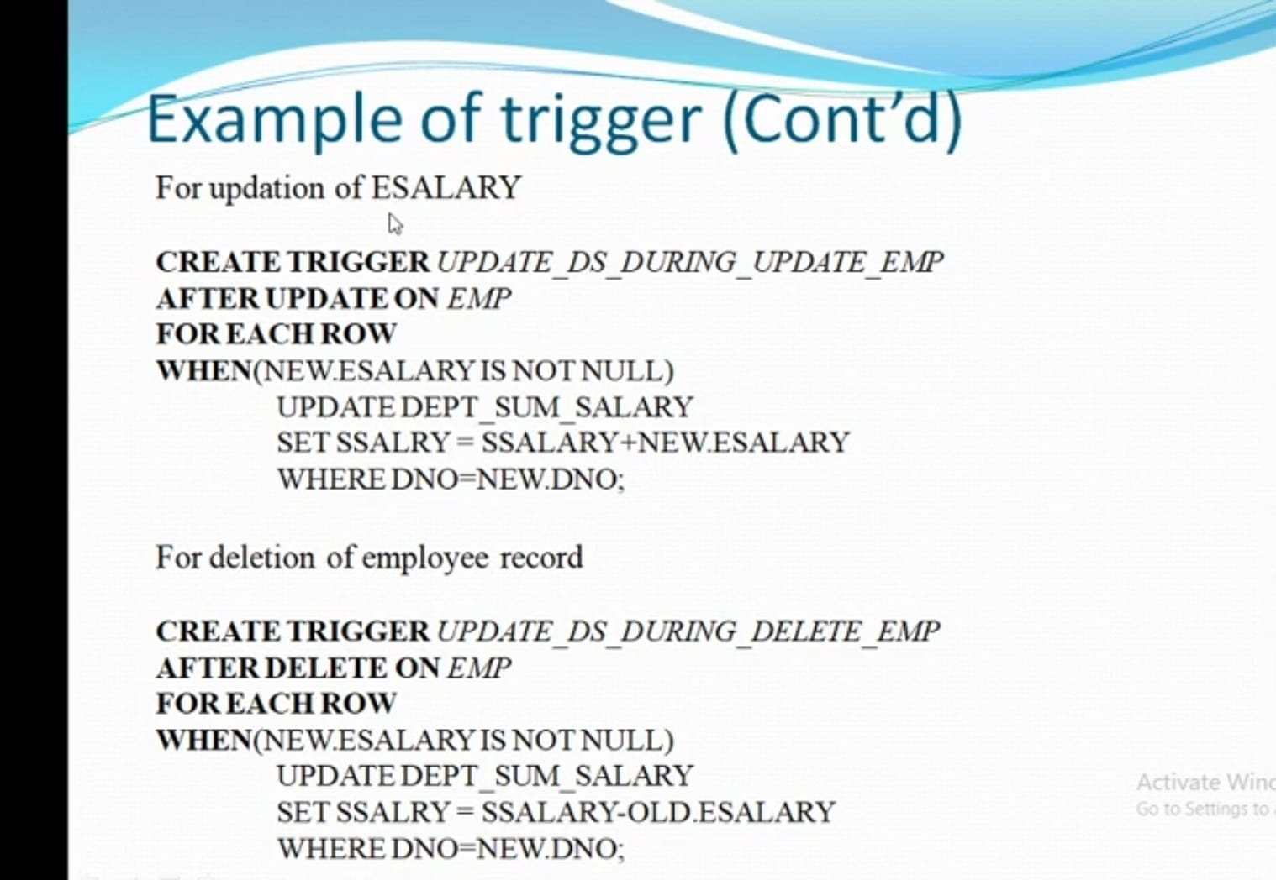

Slide 38
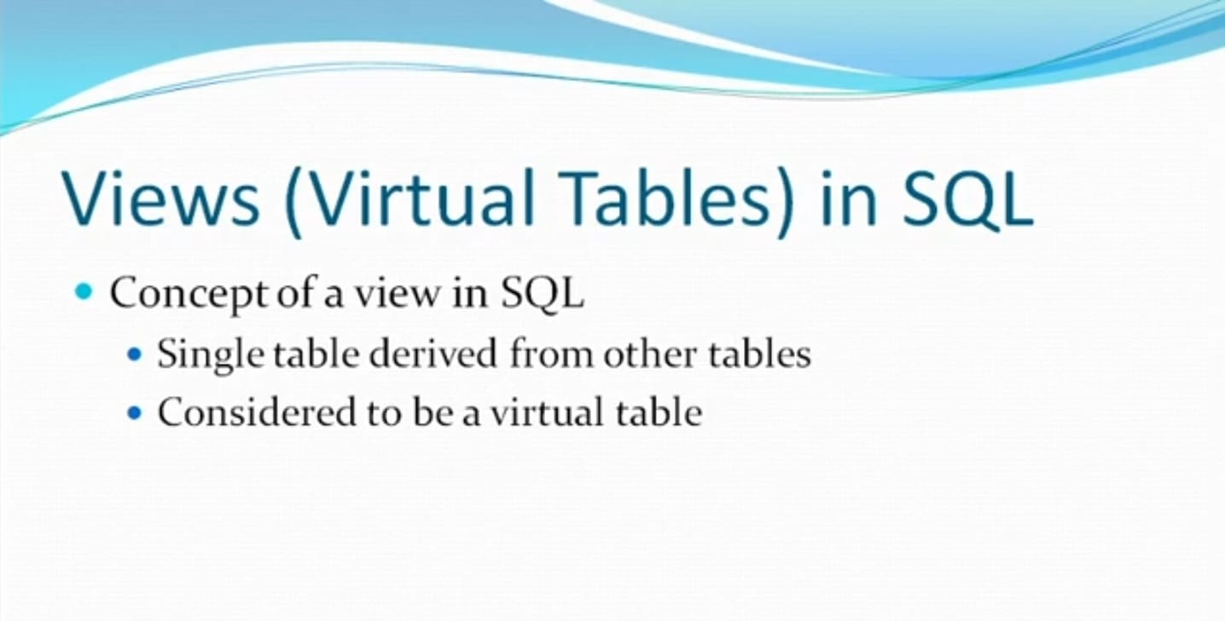

Slide 39
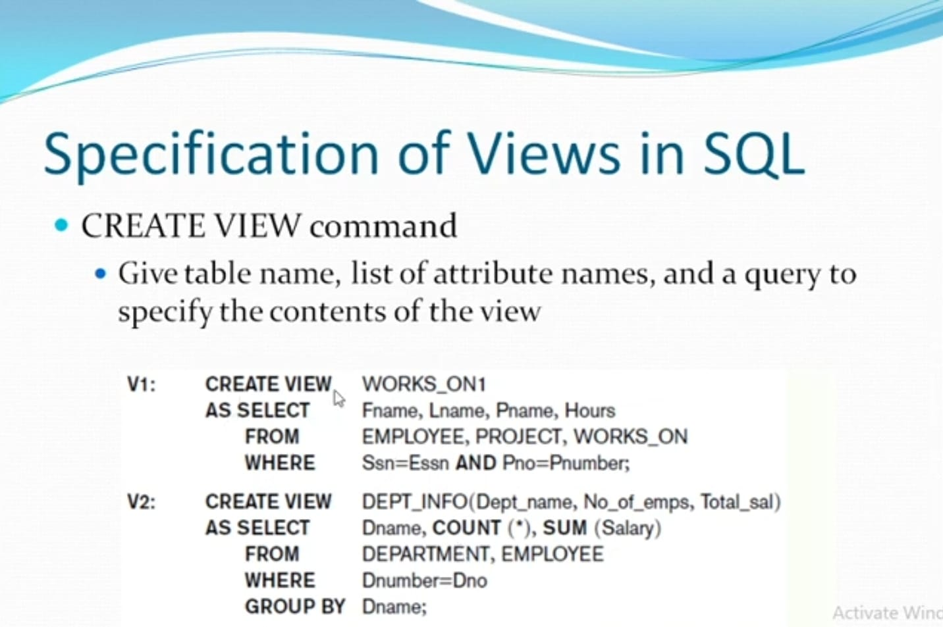

Slide 40
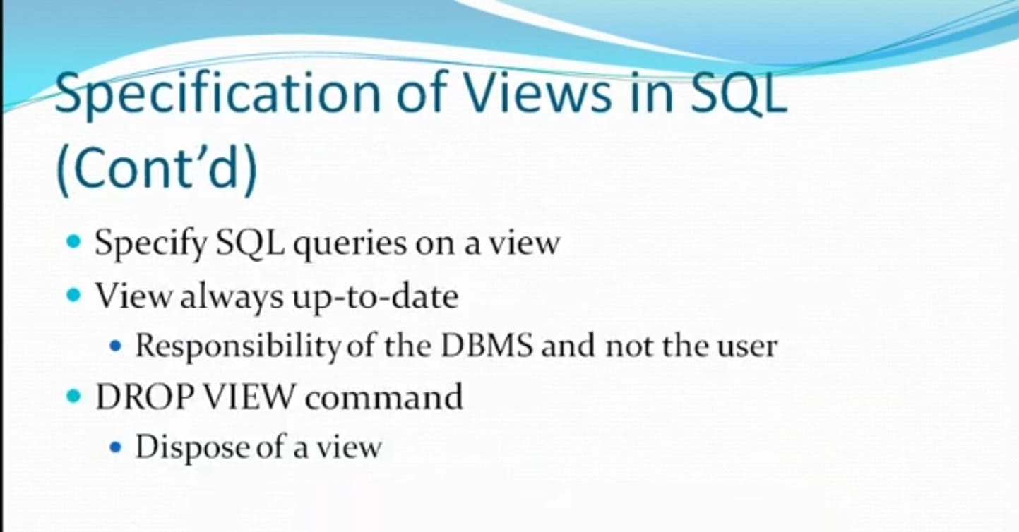

Slide 41
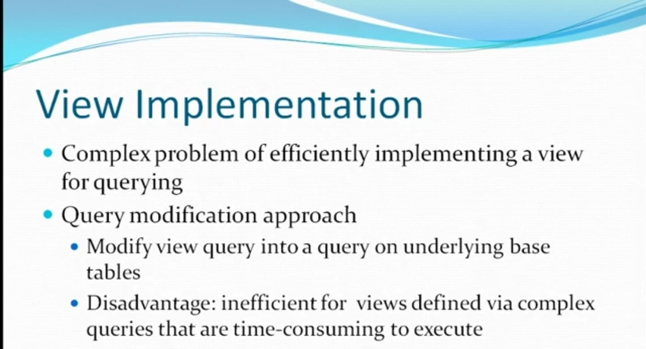

Slide 42
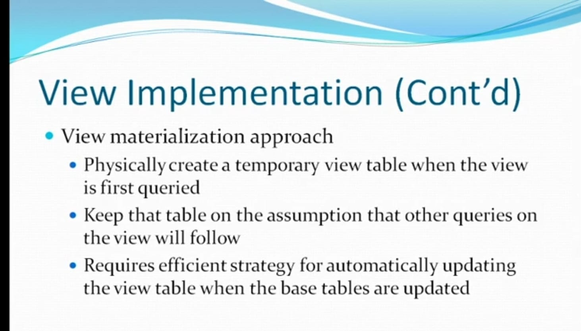

Slide 43
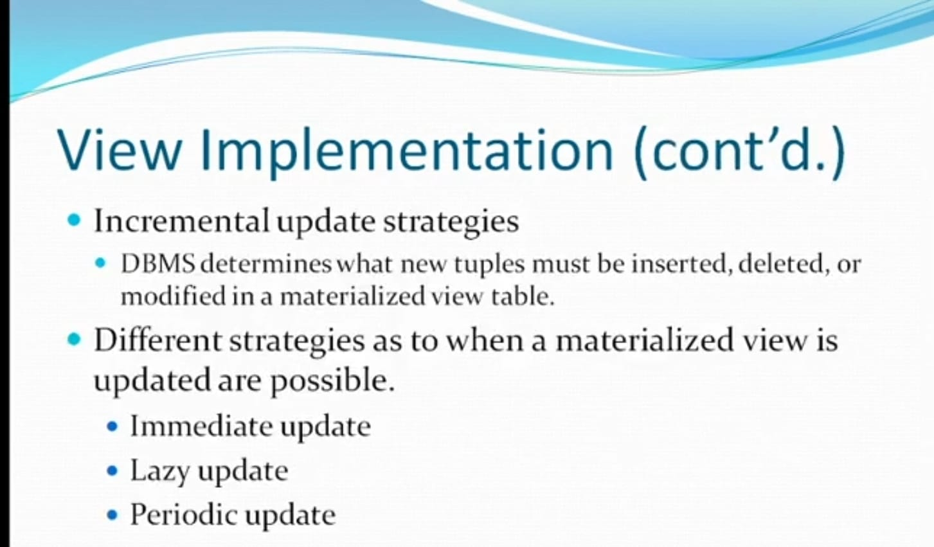

Slide 44
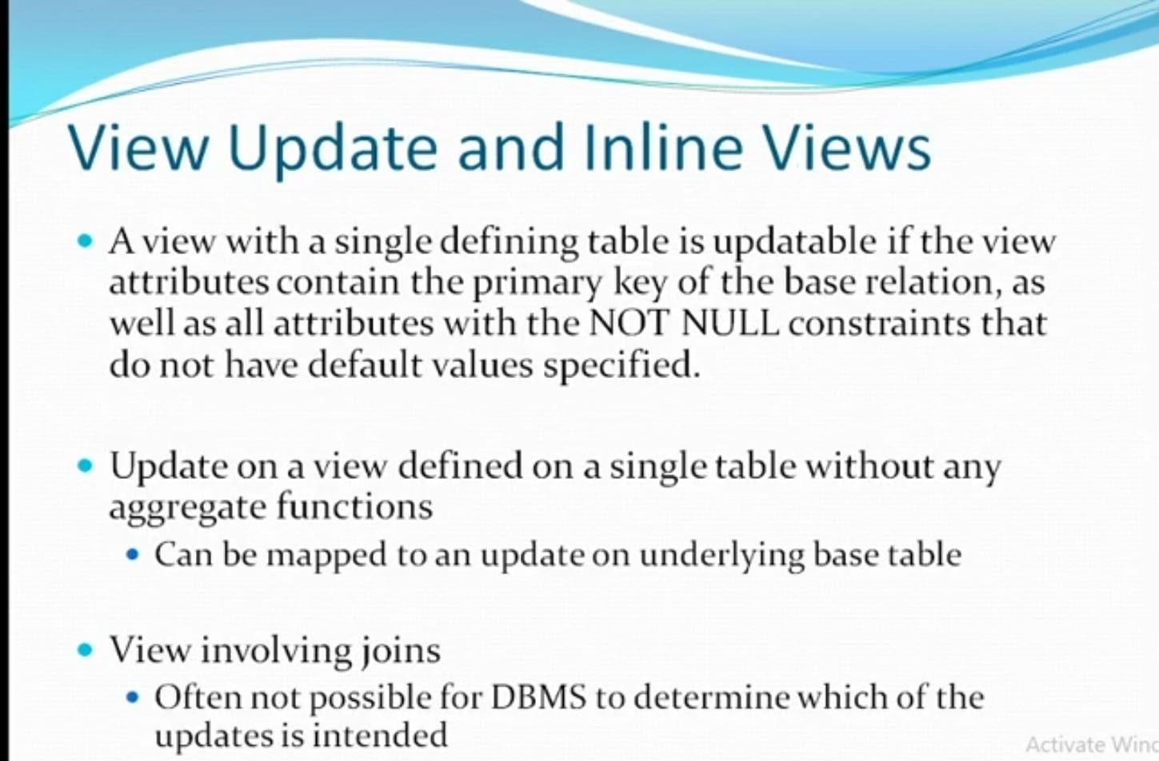

Slide 45
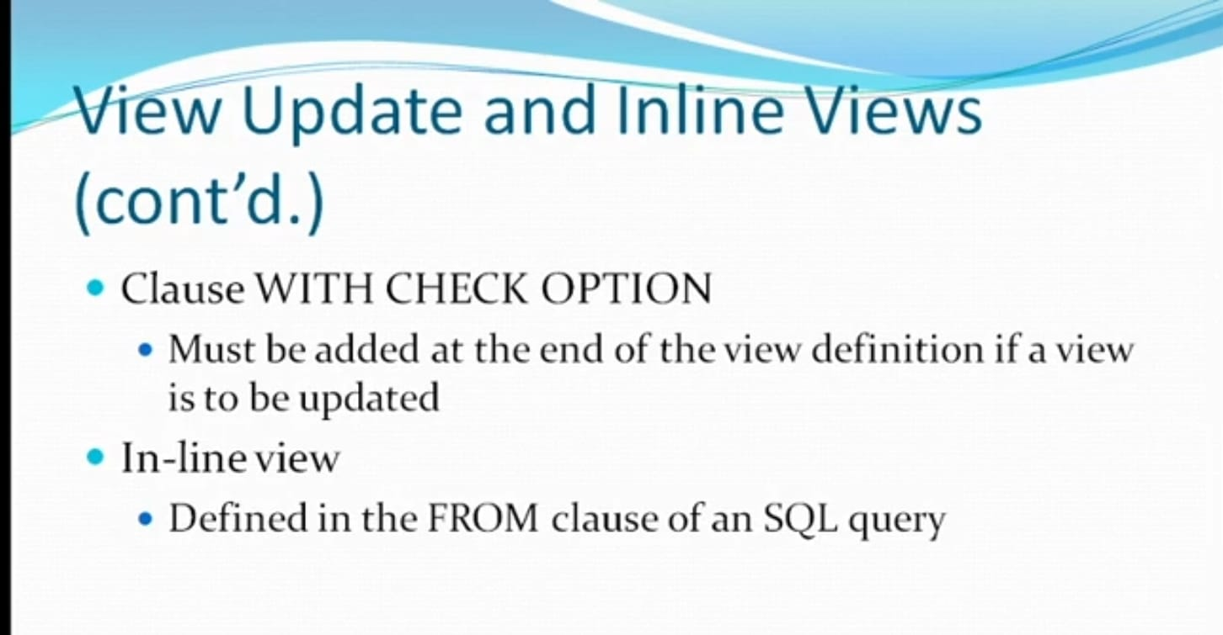

Slide 47
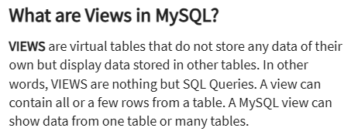

Slide 48
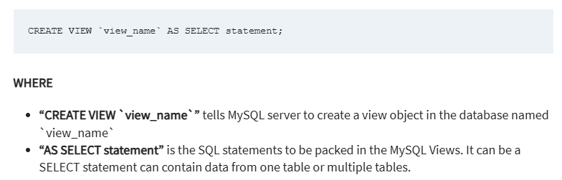

Slide 49
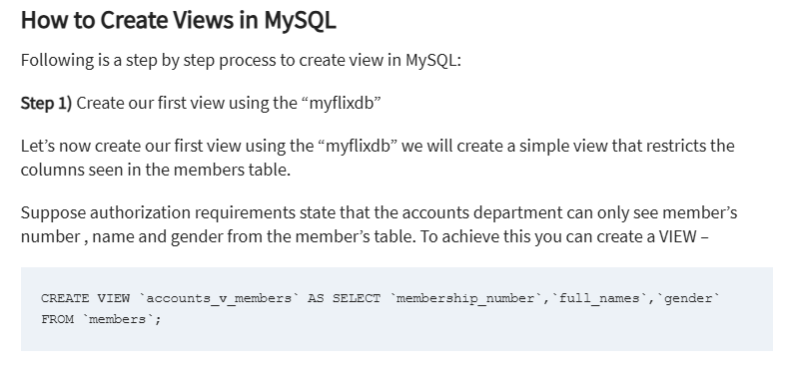

Slide 50
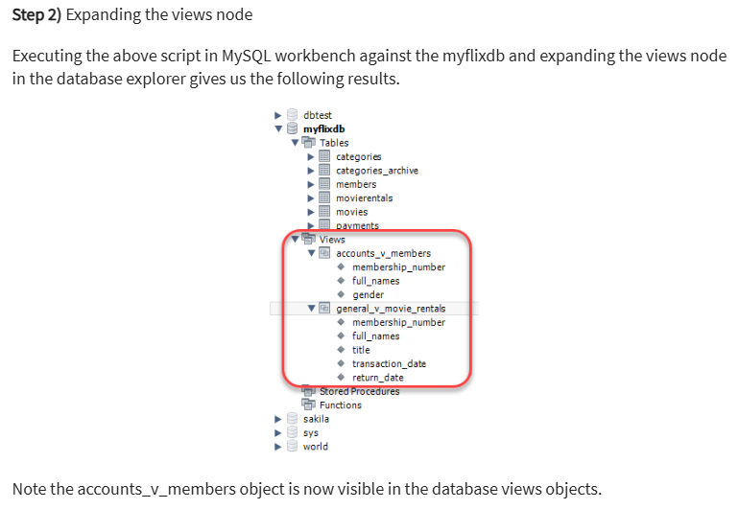

Slide 51
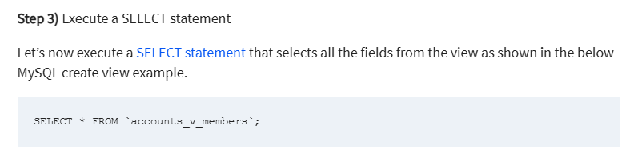

Slide 52
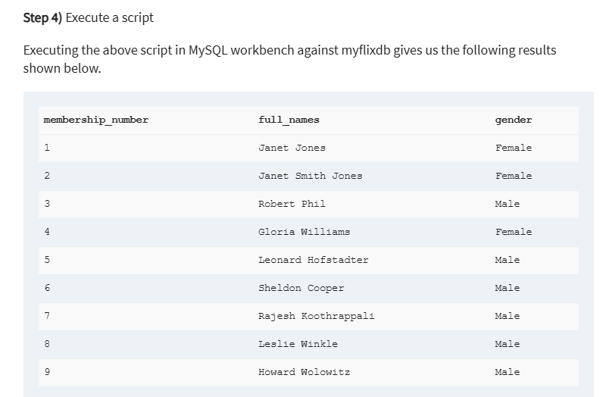

Slide 53
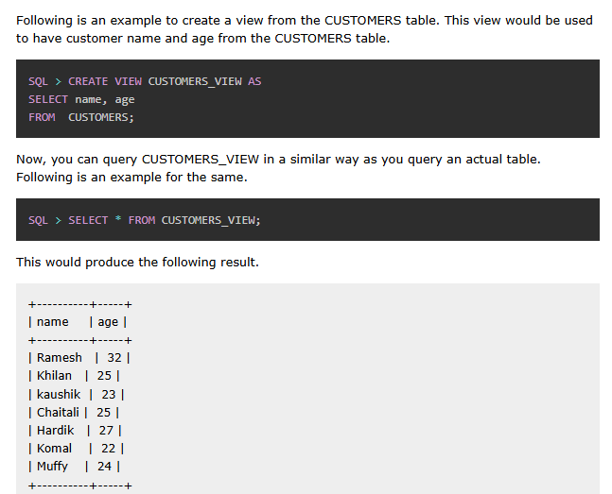

Slide 54
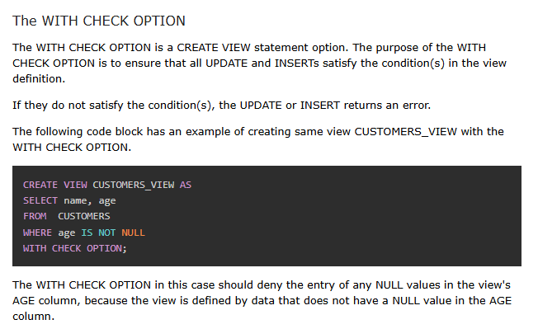

Slide 55
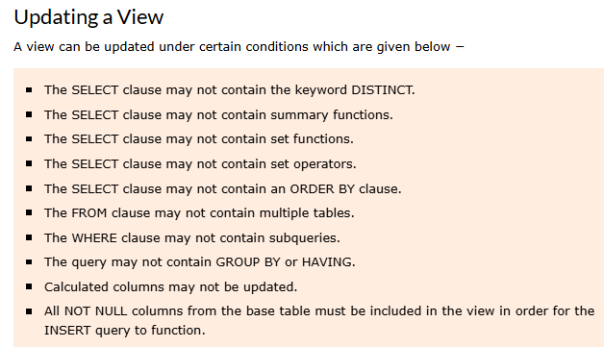

Slide 56
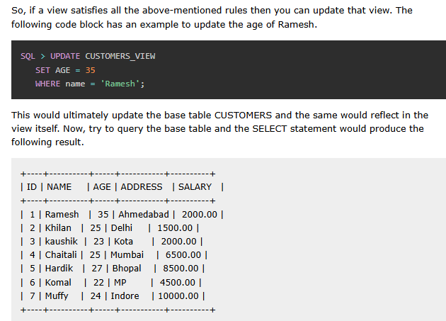

Slide 57
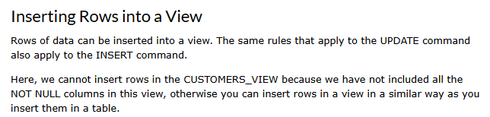

Slide 58
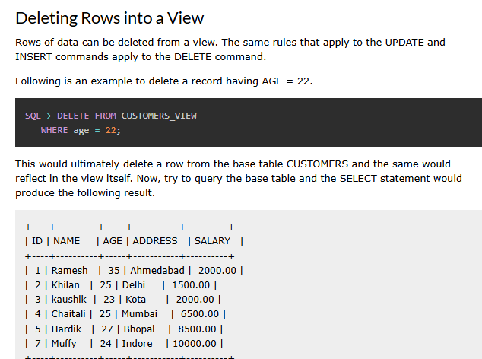

Slide 59
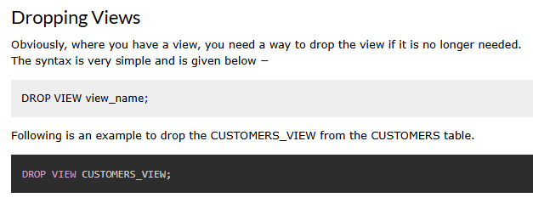

Slide 60
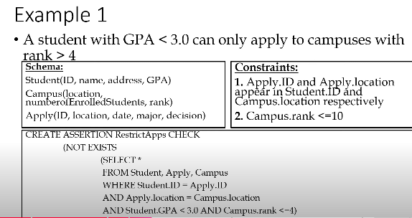

Slide 61
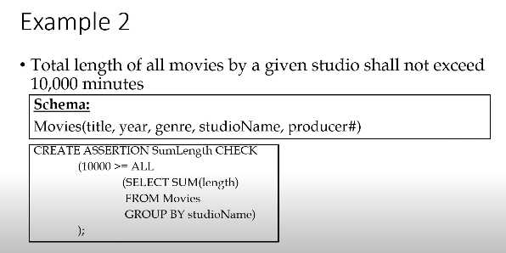

Slide 62


Slide 63
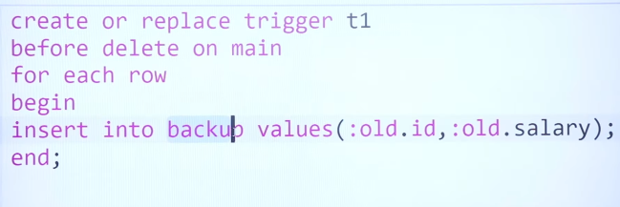

Slide 64
